Slide 1
Cornerstone City Church Peninsula Plus Community Hoo Are Ya
7th December 2025

Slide 2
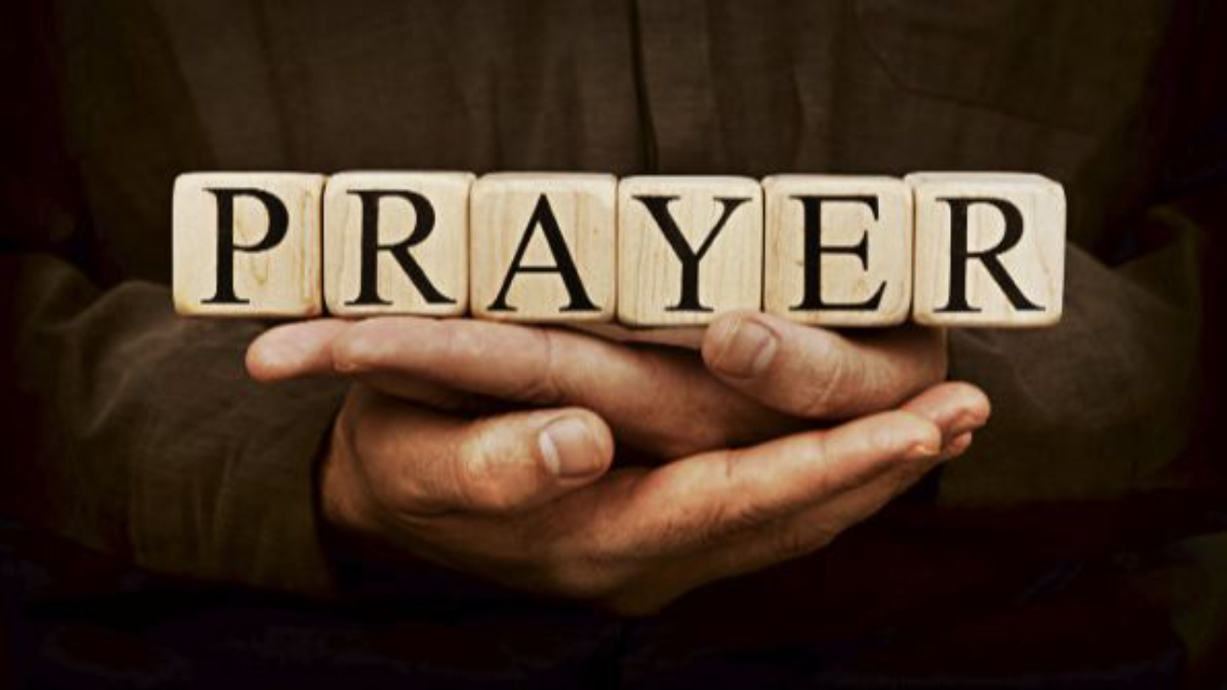

Slide 3
Praise
CCLI Song # 7213077
© Brandon Lake MusicFor Humans PublishingMaverick City PublishingCapitol CMG GenesisCapitol CMG ParagonHousefires SoundsWriter's Roof PublishingMusic by Elevation Worship Publishing
For use solely with the SongSelect® Terms of Use. All rights reserved. www.ccli.com
Note: Reproduction of this sheet music requires a CCLI Music Reproduction Licence. Please report all copies.
CCLI Licence No. 33265

Slide 4
1/12
Let everything that has breath
Praise the Lord
Praise the Lord

Slide 5
2/12
I’ll praise in the valley
Praise on the mountain
I’ll praise when I’m sure
Praise when I’m doubting

Slide 6
3/12
I’ll praise when outnumbered
Praise when surrounded
'Cause praise is the water
My enemies drown in

Slide 7
4/12
As long as I’m breathing
I’ve got a reason to Praise the Lord oh my soul
Praise the Lord oh my soul

Slide 8
5/12
I’ll praise when I feel it
And I’ll praise when I don’t
I’ll praise 'cause I know
You’re still in control

Slide 9
6/12
'Cause my praise is a weapon
It’s more than a sound
My praise is the shout
That brings Jericho down

Slide 10
7/12
As long as I’m breathing
I’ve got a reason to Praise the Lord oh my soul
Praise the Lord oh my soul

Slide 11
8/12
I won’t be quiet
My God is alive
How could I keep it inside
Praise the Lord oh my soul

Slide 12
9/12
I’ll praise 'cause You’re sovereign
Praise 'cause You reign
Praise 'cause You rose and defeated the grave
I’ll praise 'cause You’re faithful
Praise 'cause You’re true
Praise 'cause there’s nobody greater than You

Slide 13
10/12
Praise the Lord oh my soul
Praise the Lord oh my soul
Praise the Lord oh my soul
Praise the Lord oh my soul
I won’t be quiet
My God is alive
How could I keep it inside

Slide 14
1 1/12
I won’t be quiet
My God is alive
How could I keep it inside
I won’t be quiet
My God is alive
How could I keep it inside
Praise the Lord oh my soul

Slide 15
12/12
Let everything that has breath
Praise the Lord
Praise the Lord

Slide 16
Never Gonna Stop Singing
CCLI Song # 7054533
Matt Vaughan | Ran Jackson | Tom Smith
© 2015 Brand Vaughan Music (Admin. by Capitol CMG Publishing)
Capitol CMG Genesis (Admin. by Capitol CMG Publishing)
Evident Music Publishing (Admin. by Capitol CMG Publishing)
Jesus Culture Music (Admin. by Capitol CMG Publishing)
Songsmiff Publishing (Admin. by Capitol CMG Publishing)
For use solely with the SongSelect® Terms of Use. All rights reserved. www.ccli.com
CCLI Licence No. 33265

Slide 17
1/5
You called out
Into darkness
You reached down
To save us

Slide 18
2/5
You conquered the grave
You crossed the divide
Lost in our sin You made us alive
How can we ever hold it inside
We can't hold back
We're gonna lift You

Slide 19
3/5
Higher higher
Hearts burning bright like a fire fire
Voices unite make it louder louder
We're never gonna stop singing
Oo we're never gonna stop (singing)

Slide 20
4/5
Set free
No longer bound in chains
You rescued me
And called me by name

Slide 21
5/5
Every tribe every tongue
Every heart will sing
Every knee we will bow to the risen King
Lift Him up lift Him up
We're never gonna stop singing
Oo never gonna stop

Slide 23
Bless God
CCLI Song # 7206380
Brandon Lake | Brooke Ligertwood | Cody Carnes
© 2023 Brandon Lake Music; Brooke Ligertwood Designee; Capitol CMG Paragon; Writer's Roof Publishing
For use solely with the SongSelect® Terms of Use. All rights reserved. www.ccli.com

Slide 24
1/11
Blessed are those who run to Him
Who place their hope and confidence in Jesus
He won’t forsake them
Blessed are those who seek His face
Who bend their knee and fix their gaze on Jesus
They won’t be shaken

Slide 25
2/11
Come on and praise the Lord with me
Sing if you love His name
Come on and lift your voice with me
He’s worthy of all our praise

Slide 26
3/11
Blessed are those who walk with Him
Whose hearts are set on pilgrimage with Jesus
They’ll see His glory
Blessed are those who die to live
Whose joy it is to give it all for Jesus
And for Him only
Oh Jesus all for Your glory

Slide 27
4/11
Come on and praise the Lord with me
Sing if you love His name
Come on and lift your voice with me
He’s worthy of all our praise

Slide 28
5/11
Come on and bring your offering
Sing if you’ve known His grace
Come on and lift up your holy hands
He’s worthy of all our praise

Slide 29
6/11
Bless God in the sanctuary
Bless God in the fields of plenty
Bless God in the darkest valley
Every chance I get I bless Your name

Slide 30
7/11
Bless God when my hands are empty
Bless God with a praise that costs me
Bless God when nobody’s watching
Every chance I get I bless Your name

Slide 31
8/11
Bless God when the weapon’s forming
Bless God when the walls are falling
Bless God ‘cause He goes before me
Every chance I get I bless Your name

Slide 32
9/11
Bless God for He holds the vict’ry
Bless God for He’s always with me
Bless God for He’s always worthy
Every chance I get I bless Your name
Every chance I get I bless Your name

Slide 33
10/11
Come on and praise the Lord with me
Sing if you love His name
Come on and lift your voice with me
He’s worthy of all our praise

Slide 34
11/11
Come on and bring your offering
Sing if you’ve known His grace
Come on and lift up your holy hands
He’s worthy of all our praise He’s worthy of all our praise

Slide 36
In Christ Alone
CCLI Song # 3350395
Keith Getty | Stuart Townend
© 2001 Thankyou Music (Admin. by Integrity Music Ltd)
For use solely with the SongSelect® Terms of Use. All rights reserved. www.ccli.com
CCLI Licence No. 33265

Slide 37
1/4
In Christ alone my hope is found
He is my light my strength my song
This Cornerstone this solid Ground
Firm through the fiercest drought and storm
What heights of love what depths of peace
When fears are stilled when strivings cease
My Comforter my All in All
Here in the love of Christ I stand

Slide 38
2/4
In Christ alone who took on flesh
Fullness of God in helpless babe
This gift of love and righteousness
Scorned by the ones He came to save
Till on that cross as Jesus died
The wrath of God was satisfied
For every sin on Him was laid
Here in the death of Christ I live

Slide 39
3/4
There in the ground His body lay
Light of the world by darkness slain
Then bursting forth in glorious Day
Up from the grave He rose again
And as He stands in victory
Sin's curse has lost its grip on me
For I am His and He is mine
Bought with the precious blood of Christ

Slide 40
4/4
No guilt in life no fear in death
This is the power of Christ in me
From life's first cry to final breath
Jesus commands my destiny
No power of hell no scheme of man
Can ever pluck me from His hand
Till He returns or calls me home
Here in the power of Christ I'll stand

Slide 42
Mighty Name Of Jesus
CCLI Song # 7244496
Hope Darst | Jacob Sooter | Lauren Sloat
© 2024 Fair Trade Global Songs; Hope For The Best Songs; TBCO Publishing; Just When Publishing; So Essential Tunes; Remaining portion is unaffiliated
For use solely with the SongSelect® Terms of Use. All rights reserved. www.ccli.com
CCLI Licence No. 33265

Slide 43
1/9
I pray into the atmosphere
Spirit of God You're here
You have all authority
I pray over my heart and mind
I am healed by Your stripes
Your blood declares that I am free

Slide 44
2/9
In the mighty name of Jesus I pray
Calling on the power of heaven I proclaim
Every weapon formed against me must break
In the mighty name of Jesus

Slide 45
3/9
I draw a permanent boundary line
The enemy has no rights
To come near my family
No scheme could ever undo God's plans
No matter the circumstance
The cross has sealed my destiny

Slide 46
4/9
In the mighty name of Jesus, I pray
Calling on the power of heaven I proclaim
Every weapon formed against me must break
In the mighty name of Jesus

Slide 47
5/9
In the mighty name of Jesus, I know
All the power of fear and darkness must go
'Cause every key to every victory I hold
In the mighty name of Jesus

Slide 48
6/9
I will not fear I will not fear
When the enemy comes near
On the doorframe of my life
Is the blood of Jesus Christ

Slide 49
7/9
I will not fear I will not fear
There's an army of angels here
I'm protected on all sides
By the blood of Jesus Christ

Slide 50
8/9
In the mighty name of Jesus, I pray
Calling on the power of heaven I proclaim
Every weapon formed against me must break
In the mighty name of Jesus

Slide 51
9/9
In the mighty name of Jesus, I know
All the power of fear and darkness must go
'Cause every key to every victory I hold
In the mighty name of Jesus
In the mighty name of Jesus

Slide 52


Slide 53
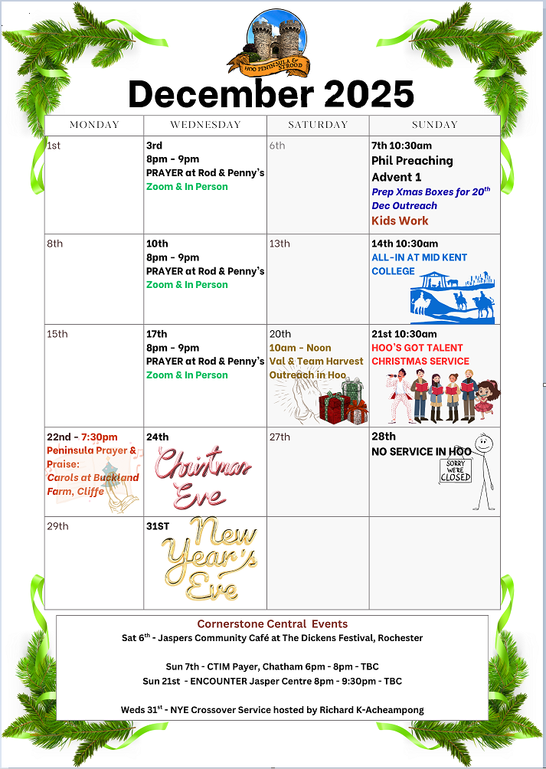

Slide 54


Slide 55



Slide 56
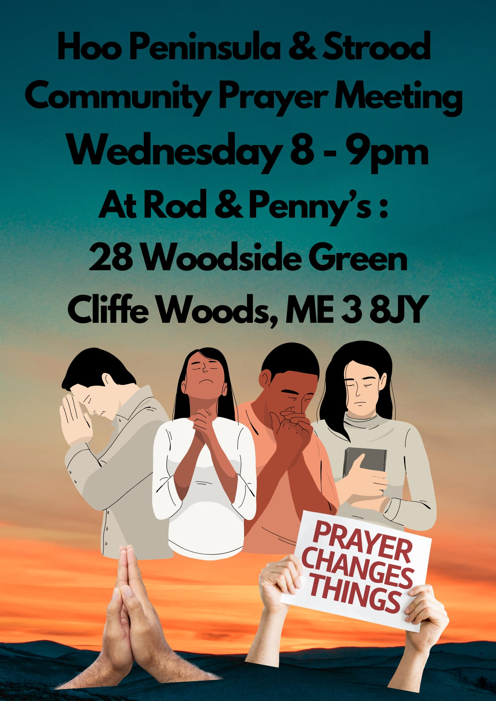

Slide 57
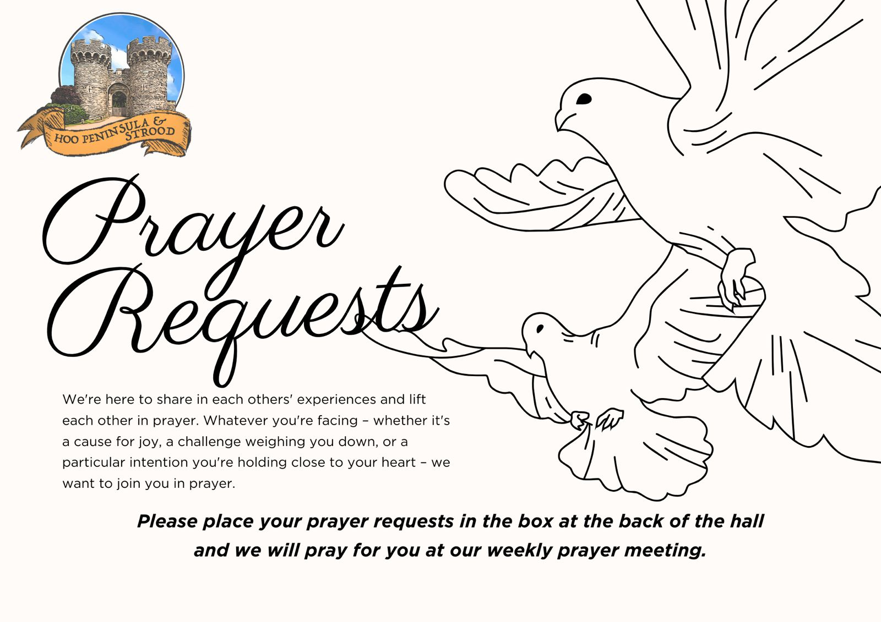

Slide 58


Slide 59
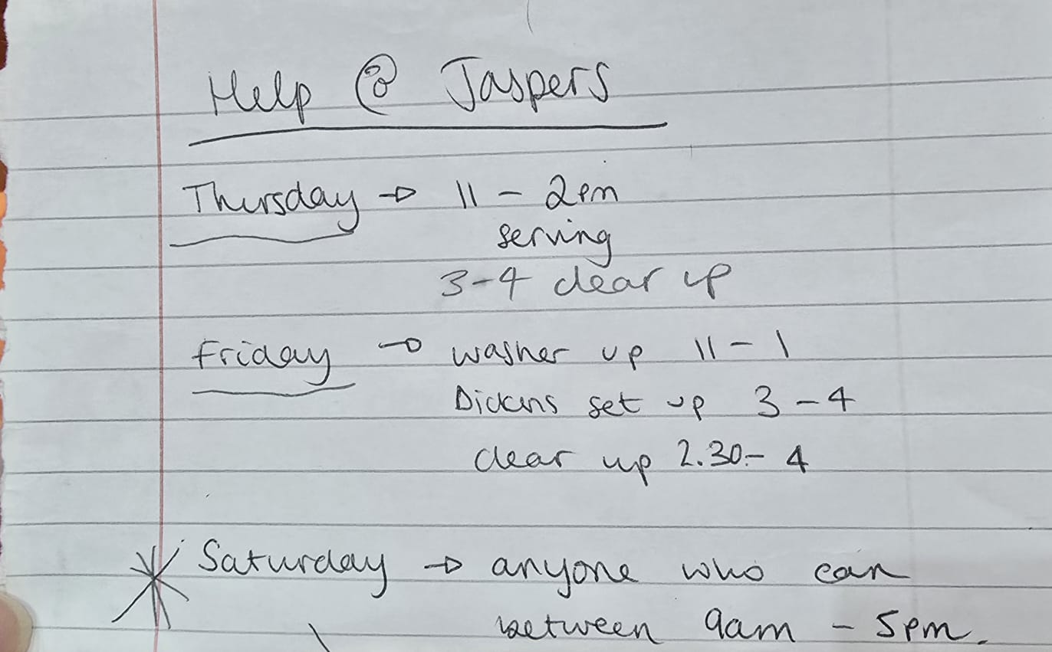

Slide 60
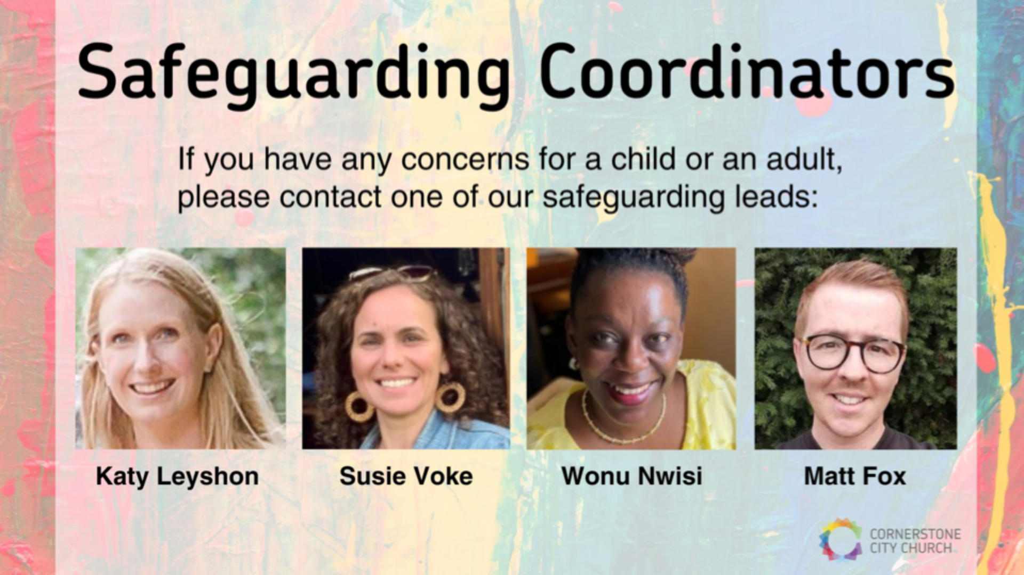

Slide 61


Slide 62


Slide 63
2 Corinthians 14 May the grace of the Lord Jesus Christ, and the love of God, and the fellowship of the Holy Spirit be with you all
Surely goodness and mercy shall follow us all the days of our lives, and we shall dwell in the house of the Lord forever.

